Slide 1
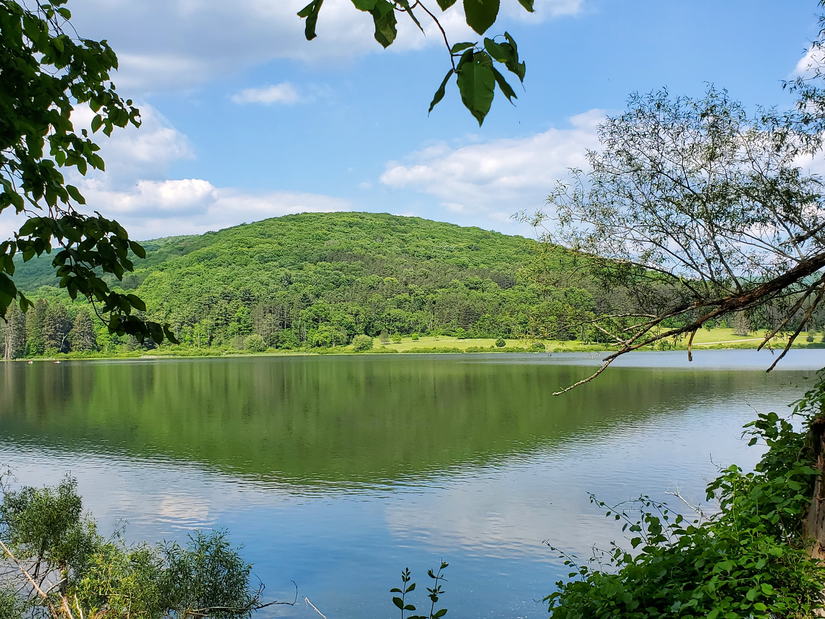
WELCOME
Allegany Baptist Church

Slide 2
CURRENT SERVICES
Sunday – 10 am
(Junior Church during service)
Wednesday – 7 pm
There is no Sunday School or
evening service at this time.

Slide 3
ANNOUNCEMENTS
Today is the last opportunity to give a love gift for Pastor Allan Maina, IGM national pastor from Kenya, who spoke a couple of weeks ago. To participate please write “Maina” on the offering envelope.
Operation Christmas Child is still in need of $160 for postage for about 40 boxes. Use the Operation Christmas Child envelopes and make checks payable to Samaritans Purse.

Slide 4
ANNOUNCEMENTS
Rev. Mark Chapman and his wife Angela will be with us as a pastoral candidate the week of October 24. Rev. Chapman will be speaking Sunday, October 24, Wednesday, October 27, and Sunday, October 31. Please be in prayer for the church and the Chapmans as we consider Rev. Chapman as our next pastor.

Slide 5
PRAYER OPPORTUNITIES
Thursday 9 am – Ladies Prayer Time
Wednesday 7 pm - Prayer Meeting
Sunday 9:30 am – All Church Prayer Time

Slide 6
PLEASE PRAY
Rev. Mark Chapman – pastor candidate
Missionaries Gary and Nancy Newhart – IGM, Rochester
Decisions regarding church ministries

Slide 7
WELCOME
Allegany Baptist Church

Slide 8
CURRENT SERVICES
Sunday – 10 am
(Junior Church during service)
Wednesday – 7 pm
There is no Sunday School or
evening service at this time.

Slide 9
ANNOUNCEMENTS
Today is the last opportunity to give a love gift for Pastor Allan Maina, IGM national pastor from Kenya, who spoke a couple of weeks ago. To participate please write “Maina” on the offering envelope.
Operation Christmas Child is still in need of $160 for postage for about 40 boxes. Use the Operation Christmas Child envelopes and make checks payable to Samaritans Purse.

Slide 10
ANNOUNCEMENTS
Rev. Mark Chapman and his wife Angela will be with us as a pastoral candidate the week of October 24. Rev. Chapman will be speaking Sunday, October 24, Wednesday, October 27, and Sunday, October 31. Please be in prayer for the church and the Chapmans as we consider Rev. Chapman as our next pastor.

Slide 11
PRAYER OPPORTUNITIES
Thursday 9 am – Ladies Prayer Time
Wednesday 7 pm - Prayer Meeting
Sunday 9:30 am – All Church Prayer Time

Slide 12
PLEASE PRAY
Rev. Mark Chapman – pastor candidate
Missionaries Gary and Nancy Newhart – IGM, Rochester
Decisions regarding church ministries

Slide 13
WELCOME
Allegany Baptist Church

Slide 14
CURRENT SERVICES
Sunday – 10 am
(Junior Church during service)
Wednesday – 7 pm
There is no Sunday School or
evening service at this time.

Slide 15
ANNOUNCEMENTS
Today is the last opportunity to give a love gift for Pastor Allan Maina, IGM national pastor from Kenya, who spoke a couple of weeks ago. To participate please write “Maina” on the offering envelope.
Operation Christmas Child is still in need of $160 for postage for about 40 boxes. Use the Operation Christmas Child envelopes and make checks payable to Samaritans Purse.

Slide 16
ANNOUNCEMENTS
Rev. Mark Chapman and his wife Angela will be with us as a pastoral candidate the week of October 24. Rev. Chapman will be speaking Sunday, October 24, Wednesday, October 27, and Sunday, October 31. Please be in prayer for the church and the Chapmans as we consider Rev. Chapman as our next pastor.

Slide 17
PRAYER OPPORTUNITIES
Thursday 9 am – Ladies Prayer Time
Wednesday 7 pm - Prayer Meeting
Sunday 9:30 am – All Church Prayer Time

Slide 18
PLEASE PRAY
Rev. Mark Chapman – pastor candidate
Missionaries Gary and Nancy Newhart – IGM, Rochester
Decisions regarding church ministries

Slide 19
WELCOME
Allegany Baptist Church

Slide 20
CURRENT SERVICES
Sunday – 10 am
(Junior Church during service)
Wednesday – 7 pm
There is no Sunday School or
evening service at this time.

Slide 21
ANNOUNCEMENTS
Today is the last opportunity to give a love gift for Pastor Allan Maina, IGM national pastor from Kenya, who spoke a couple of weeks ago. To participate please write “Maina” on the offering envelope.
Operation Christmas Child is still in need of $160 for postage for about 40 boxes. Use the Operation Christmas Child envelopes and make checks payable to Samaritans Purse.

Slide 22
ANNOUNCEMENTS
Rev. Mark Chapman and his wife Angela will be with us as a pastoral candidate the week of October 24. Rev. Chapman will be speaking Sunday, October 24, Wednesday, October 27, and Sunday, October 31. Please be in prayer for the church and the Chapmans as we consider Rev. Chapman as our next pastor.

Slide 23
PRAYER OPPORTUNITIES
Thursday 9 am – Ladies Prayer Time
Wednesday 7 pm - Prayer Meeting
Sunday 9:30 am – All Church Prayer Time

Slide 24
PLEASE PRAY
Rev. Mark Chapman – pastor candidate
Missionaries Gary and Nancy Newhart – IGM, Rochester
Decisions regarding church ministries

Slide 26
Hymn #8
Praise to the Lord,
The Almighty,
The King of creation!

Slide 27
O my soul,
Praise Him,
For He is thy
Health and salvation!

Slide 28
All ye who hear,
Now to His temple draw near;
Join me in glad adoration!

Slide 29
Praise to the Lord,
Who o’er all things so
Wondrously reigneth,

Slide 30
Shelters thee under
His wings, yes,
So gently sustaineth!

Slide 31
Hast thou not seen
How all thy longings
Have been
Granted in what He ordaineth?

Slide 32
Praise to the Lord,
Who doth prosper
Thy work
And defend thee;

Slide 33
Surely His goodness
And mercy
Here daily
Attend thee.

Slide 34
Ponder anew
What the Almighty can do,
If with His love
He befriend thee.

Slide 35
Praise to the Lord!
O let all that is
In me adore Him!

Slide 36
All that hath life
And breath,
Come now with
Praises before Him.

Slide 37
Let the Amen sound
From His people again;
Gladly for aye
We adore Him.
Public Domain

Slide 39
Hymn #497
There is a place
Of quiet rest
Near to the
Heart of God,

Slide 40
A place where sin
Cannot molest,
Near to the
Heart of God.

Slide 41
O Jesus,
Blest Redeemer,
Sent from the
Heart of God,

Slide 42
Hold us who wait
Before Thee
Near to the
Heart of God.

Slide 43
There is a place
Of comfort sweet
Near to the
Heart of God,

Slide 44
A place where we
Our Savior meet,
Near to the
Heart of God.

Slide 45
O Jesus,
Blest Redeemer,
Sent from the
Heart of God,

Slide 46
Hold us who wait
Before Thee
Near to the
Heart of God.

Slide 47
There is a place
Of full release
Near to the
Heart of God

Slide 48
A place where all
Is joy and peace
Near to the
Heart of God.

Slide 49
O Jesus,
Blest Redeemer,
Sent from the
Heart of God,

Slide 50
Hold us who wait
Before Thee
Near to the
Heart of God.
Public Domain

Slide 52
Hymn #274
Break Thou the bread of life, Dear Lord, to me,
As Thou didst break the Loaves beside the sea;

Slide 53
Beyond the sacred page
I seek Thee, Lord,
My spirit pants for Thee,
O Living Word.

Slide 54
Bless Thou the truth,
Dear Lord, to me, to me,
As Thou didst bless
The bread by Galilee;

Slide 55
Then shall all bondage cease, All fetters fall;
And I shall find my peace,
My all in all.

Slide 56
Thou art the bread of life,
O Lord, to me,
Thy holy Word the truth
That saveth me;

Slide 57
Give me to eat and live
With Thee above;
Teach me to love Thy truth, For Thou art love.

Slide 58
O send Thy Spirit, Lord,
Now unto me,
That He may touch my eyes And make me see;

Slide 59
Show me the truth Concealed within Thy Word,
And in Thy Book revealed
I see Thee Lord.
Public Domain

Slide 61
Hymn #562
Rejoice, ye pure in heart,
Rejoice, give thanks, and sing.
Your festal banner wave on high,
The cross of Christ your King.

Slide 62
Rejoice, rejoice, rejoice,
Give thanks, and sing!

Slide 63
With all the angel choirs,
With all the saints on earth,
Pour out the strains of joy and bliss,
True rapture, noblest mirth!

Slide 64
Rejoice, rejoice, rejoice,
Give thanks, and sing!

Slide 65
Yes, on through life's long path,
Still chanting as ye go;
From youth to age, by night and day,
In gladness and in woe.

Slide 66
Rejoice, rejoice, rejoice,
Give thanks, and sing!

Slide 67
Still lift your standard high,
Still march in firm array;
As warriors through the darkness
Toil till dawns the golden day.

Slide 68
Rejoice, rejoice, rejoice,
Give thanks, and sing!
Public Domain

